Slide 1
A Longitudinal Study of Global Warming Discussion on Social Media
Student: CONNOR EMERY, Bryant University
cemery1@Bryant.edu
Mentor: DR. SUHONG LI, Bryant University
sli@bryant.edu
Project owner: DR. GAURAV KHANNA, University of Rhode Island gkhanna@uri.edu​
JULIE MA jma@mghpcc.org
10/11/2023

Slide 2
Understanding Global Warming Through Social Media Discussion A Longitudinal Study of Global Warming Discussion on Social Media
Prior research from Nithisha Mucha, NDSU
Based on 50,000 tweets related to global warming over the past 10 years
Using linear support classification, found that sentiment of tweets have been mostly positive from 2014

Slide 3
Previous Research A Longitudinal Study of Global Warming Discussion on Social Media
Climate Change Sentiment on Twitter: An Unsolicited Public Opinion Poll
Study done on tweets containing keywords regarding climate change
Concluded that discussion of climate change is dominated by activists rather than deniers
Cody EM, Reagan AJ, Mitchell L, Dodds PS, Danforth CM (2015) Climate Change Sentiment on Twitter: An Unsolicited Public Opinion Poll. PLoS ONE 10(8): e0136092. https://doi.org/10.1371/journal.pone.0136092

Slide 4
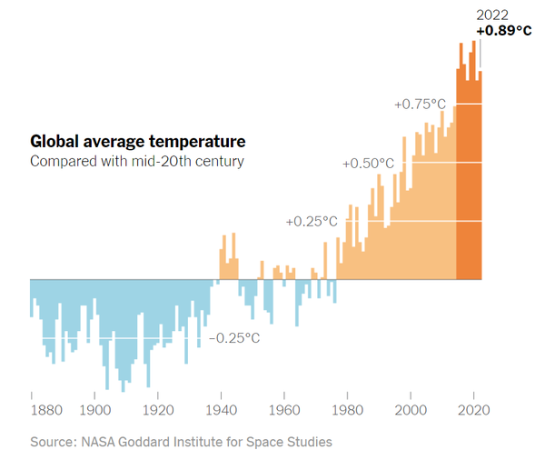
Global warming is an evident topic now and has been for years
Many people turn to social media to talk about these issues

Slide 5
Project Description A Longitudinal Study of Global Warming Discussion on Social Media
Study based on 28 million tweets collected over the past 12 years
Project aims to analyze the change in global warming sentiment over time
Topic modeling and network analysis will be used to identify what topics are popular and who the major players are
Eventual analysis of political divide and its relation to sentiment

Slide 6
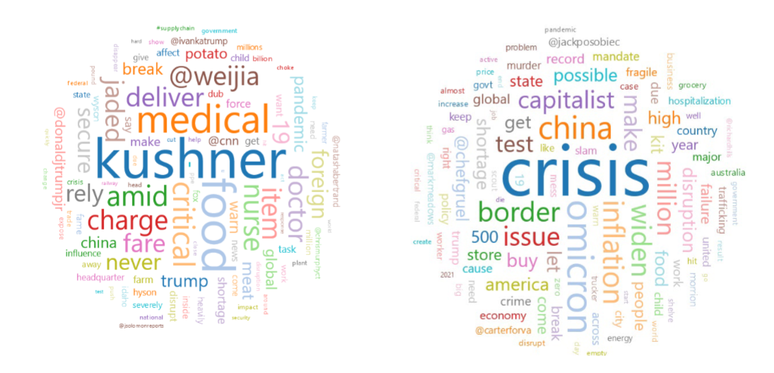
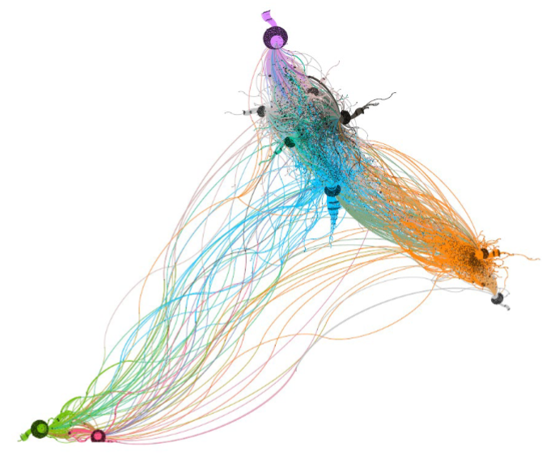
word cloud
retweet network analysis
images from “Understanding Covid-19 Impact on Supply Chain through Social Media Discussion”, Suhong Li

Slide 7
Goals A Longitudinal Study of Global Warming Discussion on Social Media
Uncover how global warming sentiment has changed over time
Use demographic information in order to identify engagement patterns over time
Perform Network analysis of discourse to understand influential users
Learn UNITY interface and how to process large datasets

Slide 8
Project timeline A Longitudinal Study of Global Warming Discussion on Social Media
February 2024
Work with faculty to interpret the results and write a report.
March 2024
wrap up development, update project git and documentation, wrap presentation. The student submits the project to a conference.
October 2023
reviews relevant literature and learn about ML, NLP and other needed libraries/packages. Set up HPC Access and project on github.
November 2023
review the twitter data set and formats the data for use by the ML, NLP, etc. software.
December 2023/January 2024
Perform extensive analysis of the formatted data using ML and NLP techniques. Sentiment analysis, topic modeling, network analysis

Slide 9
What I hope to learn A Longitudinal Study of Global Warming Discussion on Social Media
How to effectively use a high performance computing (HPC) environment for data analysis
Discover new ML and NLP techniques to strategically analyze large dataset
Find how global warming sentiment has changed over time
How our research can be applied to future studies

Slide 10
Goals for Next Month A Longitudinal Study of Global Warming Discussion on Social Media
Complete initial literature review
Review dataset with Dr. Li and begin data analysis of topic modeling and sentiment analysis
Construct a plan for analysis of data that can be shared at monthly CAREERS meeting

Slide 11
Questions? Please direct further questions to cemery1@bryant.edu

