Slide 1
Student: Natalie Vazquez Beales, Wilmington University
nvazquez002@my.wilmu.edu
Mentor: Milton Muldrow Jr., Ph.D., Wilmington University
milton.x.muldrow@wilmu.edu
Researcher: Milton Muldrow Jr., Ph.D.
KNOWING AIPTASIA PALLIDA SIRTUINS GENE CONNECTIONS TO CORAL BLEACHING

Slide 2
Abstract:
The experimentation and research of new mechanisms to protect against coral bleaching is with the use of Aiptasia Pallida as our model organism. With the utilization of the National Center for Biotechnology Information (NCBI) library of medicine, Student from Wilmington University of Delaware, will be collecting sirtuin genes data sequences which are NAD+ dependent.
We hope to find re-generating sequences, to genetically modify corals. Hoping that we can restore coral reefs starting in the Florida Keys. We must discover the connections of Sirtuin genes, proteins and transcripts to have better knowledge on how metabolic reactions occur in between the symbiotic relationship of the coral and dinoflagellate.

Slide 3
Introduction:
Our mechanism of study is Aiptasia Pallida due to its symbiotic relations and is homogeneous to other corals. Coral bleaching is our major concern. It is nothing but the absence of the symbiont dinoflagellate caused by stress due to extreme temperature changes and most of its food source.
The nutrients offered by the algae are glucose, oxygen and fixed carbon by photosynthesis using NAD+.

Slide 4
Materials and Methods:
-The use of National Center for Biotechnology Information (NCBI) library of medicine to find sequences of interest.
- To start the search, you have to input the individual name and look for sirtuins, each one individually, for both human and Aiptasia.
-To run BLAST, there’s specific slot for protein comparison as well as transcripts and genes.
-Utilize the genome viewer data sequence, Dot Pairwise and Pairwise comparison.
- Later on in lab experimentation to study the genome of Aiptasia pallida, we are taking an approach of administering a NAD+ Supplement.
- Aiptasia pallida will be kept and maintained in two tanks: (10-20) gallon tank each
- One tank for symbiotic and the other for aposymbiotic/asymbiotic (with and without algae).

Slide 5
Data Collected:
The Query cover 89%, means that the percentage of the sequence is aligned to that percentage of that specific subject and that 11% of the sequence is not aligned. The E value should be no more than 10E. The Per identity of 59.39% means that this percentage is identical to our protein sequence of the subject of interest. Query cover should be high, E value should be low and the Per identity should be high, to know that our sequence is homologous to the subject sequence.

Slide 6
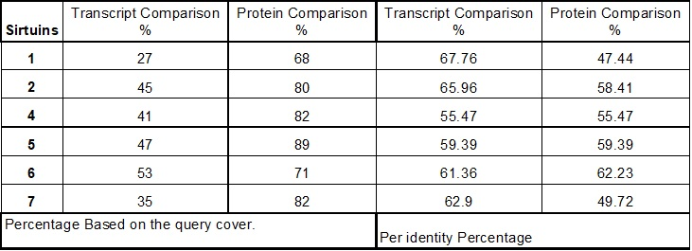
Data Collected Continued:

Slide 7
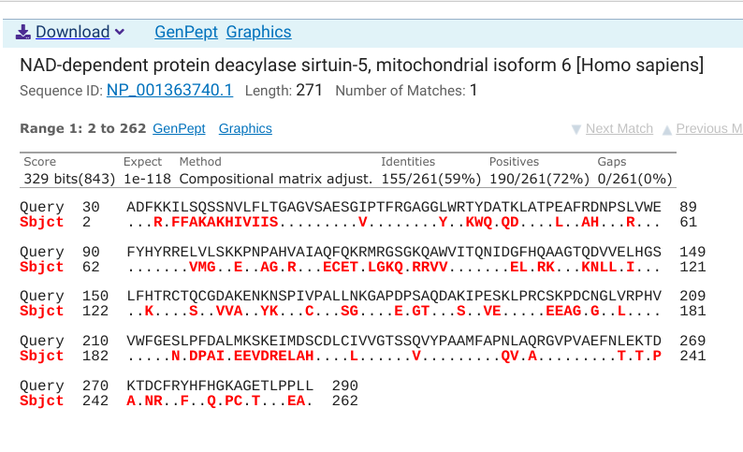
Results Dot alignment sequence comparison:
-The red letters are differing Amino Acids in the subject sequence.

Slide 8
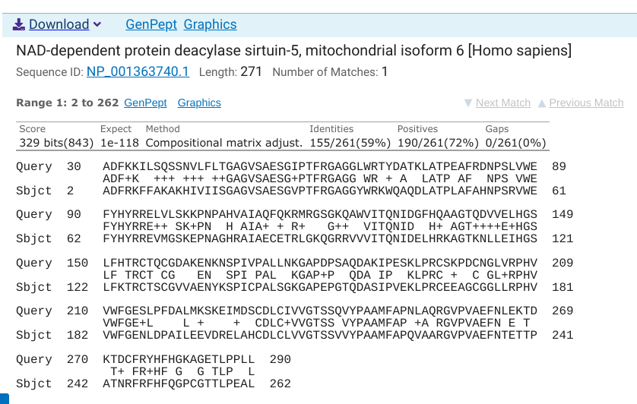
Results Pairwise sequence comparison:
- The letters display an identical match.
-The + is a positive match= conservative substitution
-White space is match with zero or negative score
- Dashes represent gaps.

Slide 9
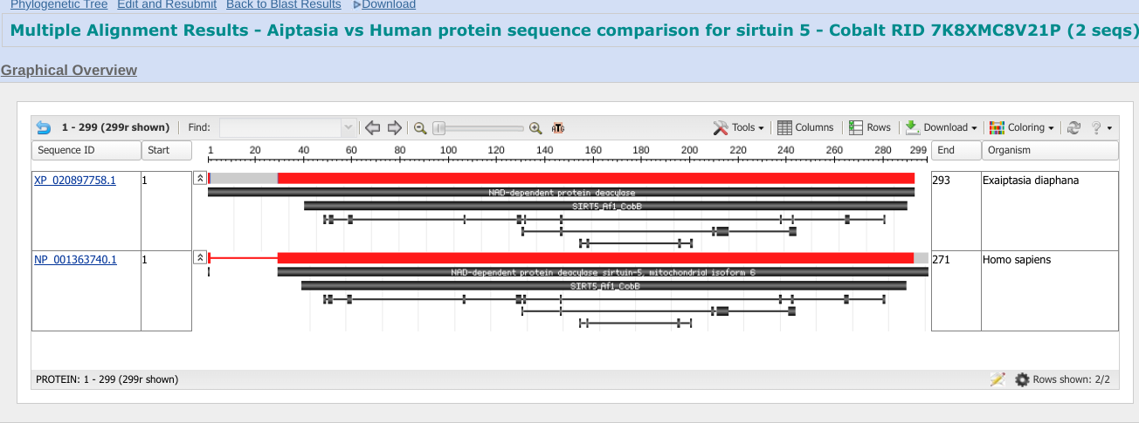
Multiple Sequence Alignment view of sirtuin 5 for Aiptasia vs Human

Slide 10
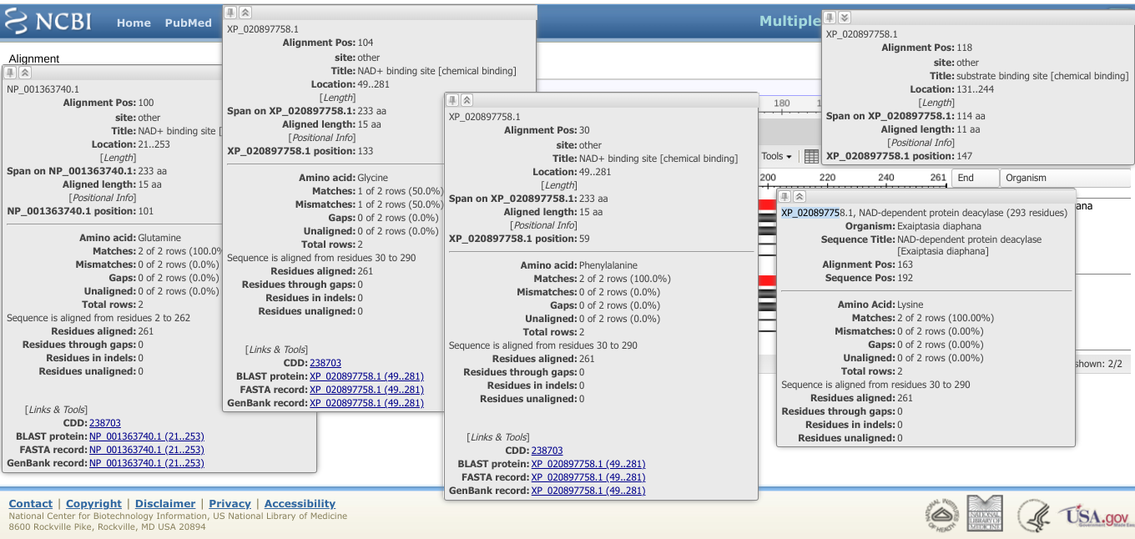
Multiple Sequence Alignment view for Sirtuin 5 Aiptasia vs Human

Slide 11
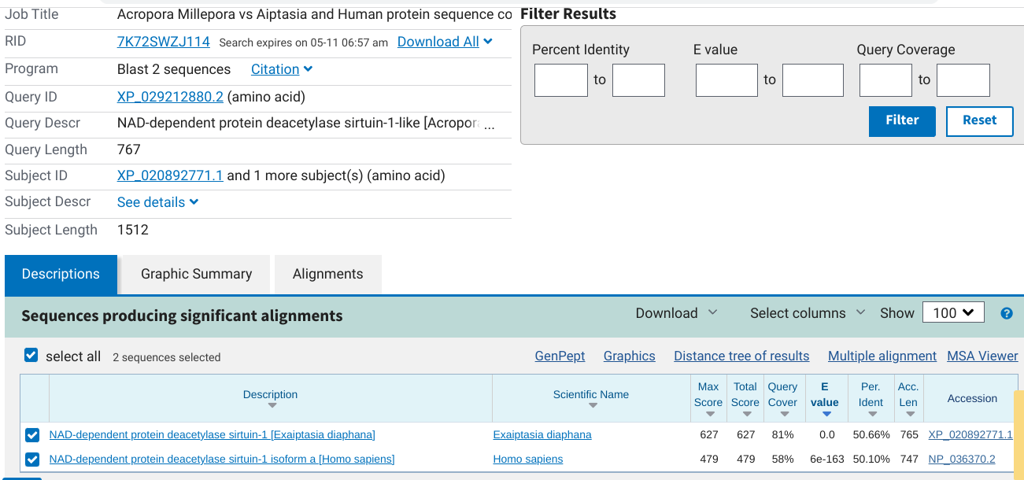
Sirtuin 1 Comparison in between Acropora Millepora, Aiptasia and Human

Slide 12
What we accomplished
We can determine that there’s a lot of similarities in the Query Cover between Aipatasia and human sirtuins, is that they may overlap in their metabolic functions. These functions of gene maintenance and metabolism may influence bleaching.

Slide 13
Lessons Learned:
We were able to access and interpret the bioinformatic data collected, when comparing the sequences.
We were able to analyze Sirtuins proteins and transcripts.
We still have to analyze the genetic implication of what actually triggers the stress. Meaning to have a comparison of a coral before and after the stress.

Slide 14
References:
U.S. National Library of Medicine. (n.d.). Blast: Basic local alignment search tool. National Center for Biotechnology Information. Retrieved March 18, 2022, from https://blast.ncbi.nlm.nih.gov/Blast.cgi
Stephen F. Altschul, Thomas L. Madden, Alejandro A. Schäffer, Jinghui Zhang, Zheng Zhang, Webb Miller, and David J. Lipman (1997), "Gapped BLAST and PSI-BLAST: a new generation of protein database search programs", Nucleic Acids Res. 25:3389-3402.
Developing the anemone Aiptasia as a tractable model for cnidarian-dinoflagellate symbiosis: the transcriptome of aposymbiotic A. pallida.Lehnert EM, et al. BMC Genomics, 2012 Jun 22. PMID 22726260, Free PMC Article
U.S. National Library of Medicine. (n.d.). Search: Aiptasia pallida [longevity genes] - NLM. National Center for Biotechnology Information. Retrieved February 22, 2022, from https://www.ncbi.nlm.nih.gov/search/all/?term=aiptasia+pallida+%5Blongevity+genes%5D
U.S. National Library of Medicine. (n.d.). Blast: Basic local alignment search tool. National Center for Biotechnology Information. Retrieved March 19, 2022, from https://blast.ncbi.nlm.nih.gov/Blast.cgi#alnHdr_1776945216
LD;, E. M. A. D. B. A. M. (n.d.). Cnidarian pattern recognition Receptor Repertoires reflect Both Phylogeny and life history traits. Frontiers in immunology. https://pubmed.ncbi.nlm.nih.gov/34248980/.
Nature Publishing Group. (n.d.). Nature news. https://www.nature.com/articles/s41392-020-00311-7/figures/1
Randle, J. L., Cárdenas, A., Gegner, H. M., Ziegler, M., & Voolstra, C. R. (1AD, January 1). Salinity-conveyed thermotolerance in the coral model aiptasia is accompanied by distinct changes of the bacterial microbiome. Frontiers. https://www.frontiersin.org/articles/10.3389/fmars.2020.573635/full.
Weizman, E., & Levy, O. (2019, August 2). The role of Chromatin DYNAMICS under global warming response in the symbiotic Coral MODEL AIPTASIA. Nature News. https://www.nature.com/articles/s42003-019-0543-y#Fig3

Slide 15
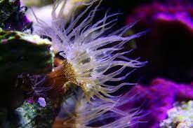
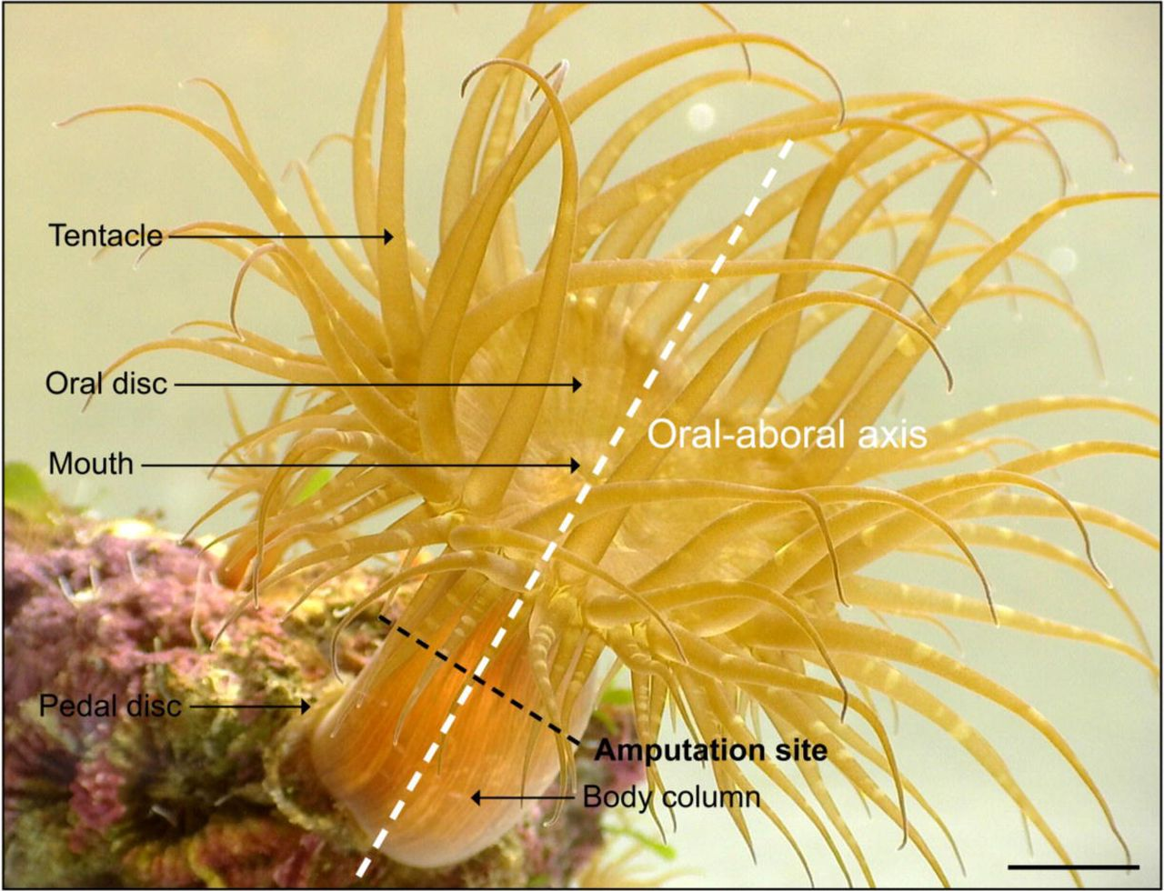
KNOWING AIPTASIA PALLIDA SIRTUINS GENE CONNECTIONS TO CORAL BLEACHING Presented by Natalie Vazquez Beales under the Supervision of Milton Muldrow Jr., Ph.D. Environmental Science & Policy Chair
Abstract:
With the understanding of this experimentation, we hope to find re-generating sequences, to genetically modify corals. Hoping that we can restore coral reefs starting in the Florida Keys. We must discover the connections of Sirtuin genes, proteins and transcripts to have better knowledge on how metabolic reactions occur in between the symbiotic relationship of the coral and dinoflagellate. The experimentation and research of new mechanisms to protect against coral bleaching is with the use of Aiptasia Pallida as our model organism. With the utilization of the National Center for Biotechnology Information (NCBI) library of medicine, Student from Wilmington University of Delaware, will be collecting sirtuin genes data sequences which are NAD+ dependent.
Introduction:
Coral reefs are underwater structures formed by colonial marine invertebrate skeletons; they are the home to over one million species and each individual coral is called a “polyp”.Within them resides a dinoflagellate (an algae) it offers nutrients like glucose, oxygen and fixed carbon by photosynthesis using NAD+. The endosymbiosis is with a photosynthetic dinoflagellate algae from the Symbiodiniaceae family. Our mechanism of study is Aiptasia Pallida due to its symbiotic relations and is homogeneous to other corals. Coral bleaching is our major concern. It is nothing but the absence of the symbiont dinoflagellate caused by stress due to extreme temperature changes and most of its food source.
Goals:
Examine hydra metabolic function as well as learn how to both access and interpret bioinformatic data utilizing BLAST (It is a the Gene Bank of all organisms studied).
Analyze genetic implications of coral metabolic function, to learn what causes stress.
Analyze model organisms for the sirtuin proteins and genes. Key components of interest: Sirtuins which are activated by NAD+.
Understanding metabolism, because in the absence of NAD+, there might be glucose intolerance, which causes stress.
Results:
Materials & Methods:
Discussion:
-The use of National Center for Biotechnology Information (NCBI) library of medicine to find sequences of interest.
- To start the search, you have to input the individual name and look for sirtuins, each one individually. For both human and Aiptasia.
-To run BLAST, there’s specific slot for protein comparison as well as transcripts and genes.
-Utilize the genome viewer data sequence, Dot Pairwise and Pairwise comparison.
Later on in lab experimentation to study the genome of Aiptasia pallida, we are taking an approach of administering a NAD+ Supplement.
- Aiptasia pallida will be kept and maintained in two tanks: (10-20) gallon tank each
- One tank for symbiotic and the other for aposymbiotic/asymbiotic (with and without algae)
As mentioned before our mechanism of study is Aiptasia Pallida due to its symbiotic relations. The algae resides inside the host gastrodermal cells within vesicles called symbiosomes, shown in part D of the image above. There’s a frequency of apoptosis and necrosis cell death due to relevant doses of heat stress. We need to understand the thermal stress gene regulation and gene activity. Nicotinamide Adenine Dinucleotide (NAD+) is found in all living things, it might be the key component, as well as the microalgal symbiotic interaction. NAD+ is a cofactor for enzymes involved in glycolysis, the production of energy from glucose. We hypothesize that the stress is occurring due to the absence of NAD+, the algae keeps producing glucose and it causes the coral to expulse the algae by exocytosis. Sirtuins play a big role, they are activated by NAD+, the proteins influence in aging and longevity through molecular pathways, they regulate metabolic processes, response to stress, and modulation of lifespan. On the top image in the center, the most important results when interpreting data are Query coverage, E value and the Per identity. The Query cover 89%, means that the percentage of the sequence is aligned to that percentage of that specific subject and that 11% of the sequence is not aligned. The E value should be no more than 10E. The Per identity of 59.39% means that this percentage is identical to our protein sequence of the subject of interest. Query cover should be high, E value should be low and the Per identity should be high, to know that our sequence is homologous to the subject sequence. We can determine that there’s a lot of similarities in the Query cover between Aipatasia and human sirtuins that they may overlap in their metabolic functions. These functions of gene maintenance and metabolism may influence bleaching.
U.S. National Library of Medicine. (n.d.). Blast: Basic local alignment search tool. National Center for Biotechnology Information. Retrieved March 18, 2022, from https://blast.ncbi.nlm.nih.gov/Blast.cgi
Stephen F. Altschul, Thomas L. Madden, Alejandro A. Schäffer, Jinghui Zhang, Zheng Zhang, Webb Miller, and David J. Lipman (1997), "Gapped BLAST and PSI-BLAST: a new generation of protein database search programs", Nucleic Acids Res. 25:3389-3402.
Developing the anemone Aiptasia as a tractable model for cnidarian-dinoflagellate symbiosis: the transcriptome of aposymbiotic A. pallida.Lehnert EM, et al. BMC Genomics, 2012 Jun 22. PMID 22726260, Free PMC Article
U.S. National Library of Medicine. (n.d.). Search: Aiptasia pallida [longevity genes] - NLM. National Center for Biotechnology Information. Retrieved February 22, 2022, from https://www.ncbi.nlm.nih.gov/search/all/?term=aiptasia+pallida+%5Blongevity+genes%5D
U.S. National Library of Medicine. (n.d.). Blast: Basic local alignment search tool. National Center for Biotechnology Information. Retrieved March 19, 2022, from https://blast.ncbi.nlm.nih.gov/Blast.cgi#alnHdr_1776945216
LD;, E. M. A. D. B. A. M. (n.d.). Cnidarian pattern recognition Receptor Repertoires reflect Both Phylogeny and life history traits. Frontiers in immunology. https://pubmed.ncbi.nlm.nih.gov/34248980/.
Nature Publishing Group. (n.d.). Nature news. https://www.nature.com/articles/s41392-020-00311-7/figures/1
Randle, J. L., Cárdenas, A., Gegner, H. M., Ziegler, M., & Voolstra, C. R. (1AD, January 1). Salinity-conveyed thermotolerance in the coral model aiptasia is accompanied by distinct changes of the bacterial microbiome. Frontiers. https://www.frontiersin.org/articles/10.3389/fmars.2020.573635/full.
Weizman, E., & Levy, O. (2019, August 2). The role of Chromatin DYNAMICS under global warming response in the symbiotic Coral MODEL AIPTASIA. Nature News. https://www.nature.com/articles/s42003-019-0543-y#Fig3
References
Acknowledgements
This research was made possible by the Delaware Space Grant College Program, NASA Grant #NNX15AI19H and Wilmington University. Collaborators from Wilmington University include Milton Muldrow Jr., Ph. D. Environmental Science and Policy Chair

